Slide 1
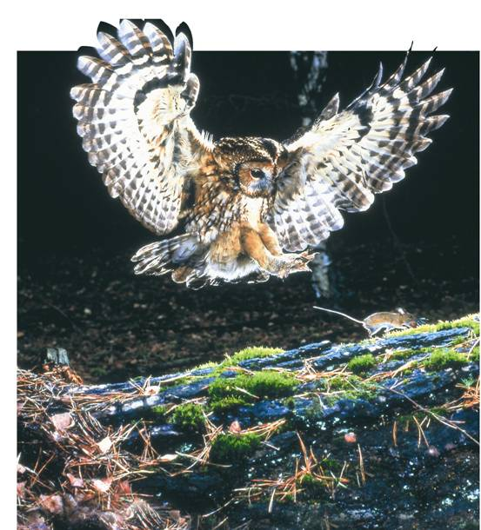
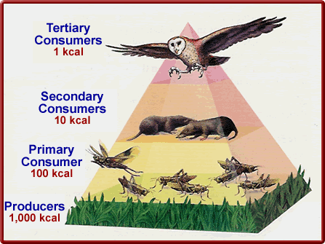
Biology
MT: Ecology Energy Pyramid
I will understand that in each link in a food web, some energy is stored in newly made structures and some is dissipated as heat, dissipation may be represented in an energy pyramid.
Copyright Pearson Prentice Hall
Notes:
*
Photo Credit: ©Bruce Coleman, LTD/Natural Selection

Slide 2
*Where does the energy for life come from?
Sunlight!
Sunlight is the main energy source for life on Earth – producers make sugar from it!
Copyright Pearson Prentice Hall
Notes:
*

Slide 3
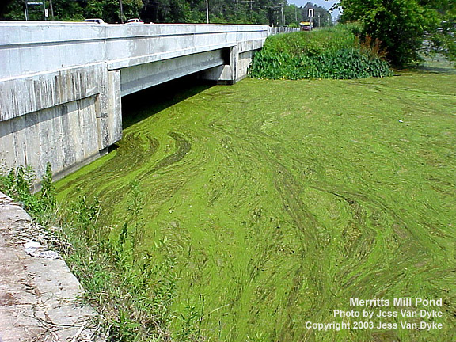
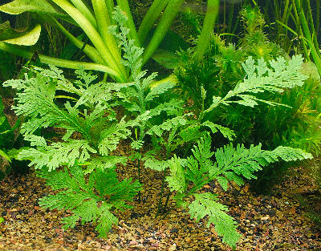
Producers/Autotroph
Only plants, some algae, and certain bacteria can capture energy from sunlight or chemicals and use that energy to produce food.
Copyright Pearson Prentice Hall
Notes:
*

Slide 4
Producers
Energy From the Sun
During photosynthesis, these autotrophs use light energy to convert carbon dioxide and water into oxygen and sugar (glucose).
CO₂ + H₂O + sunlight = C₆H₁₂O6 + O₂
Copyright Pearson Prentice Hall
Notes:
*

Slide 5
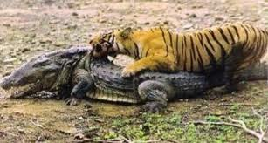
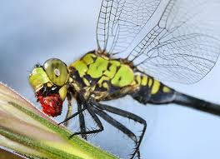
Consumers
Consumers
Organisms that rely on other organisms for their energy and food supply are called heterotrophs/consumers.
Notes:
*

Slide 6
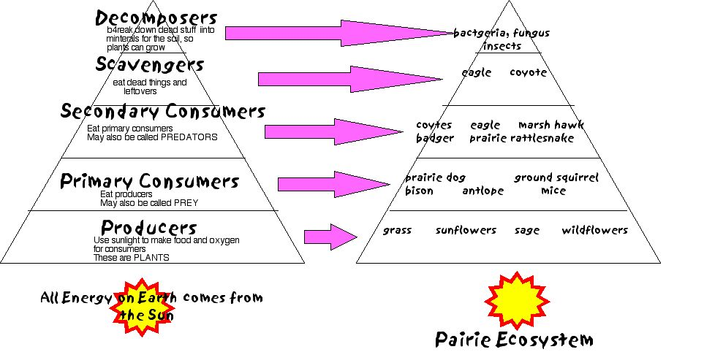
Feeding Relationships
*How does energy flow through living systems?
Copyright Pearson Prentice Hall
Notes:
*

Slide 7
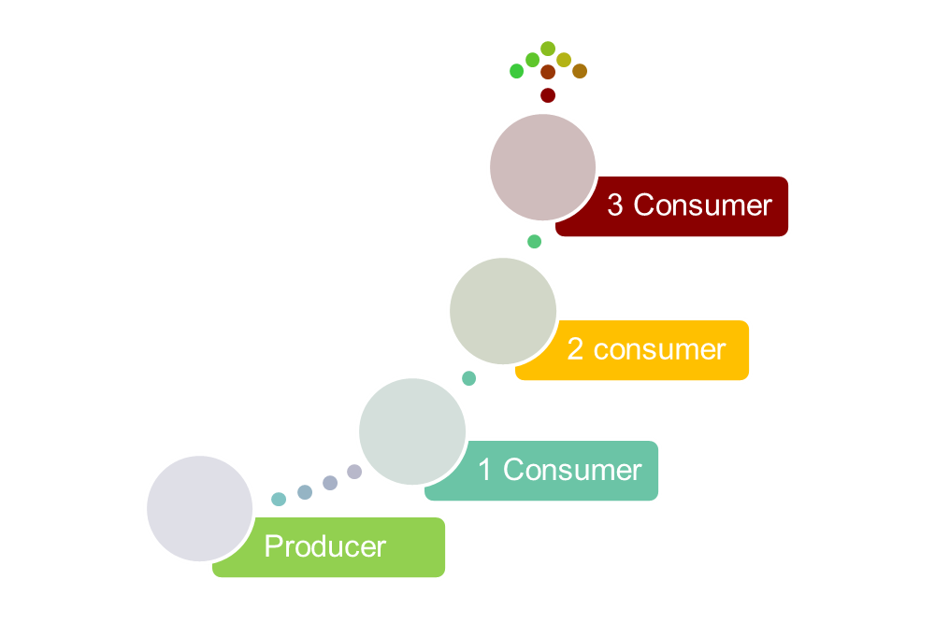
*Energy flows through an ecosystem in one direction
from the sun to autotrophs (producers) and then to heterotrophs (consumers).
Copyright Pearson Prentice Hall
Notes:
*

Slide 8
Feeding Relationships
Small Fish
Zooplankton
Squid
Algae
Shark
2 consumer
1 consumer
3 consumer
producer
4 consumer
Copyright Pearson Prentice Hall
Notes:
*
Food chains show the one-way flow of energy in an ecosystem. In this marine food chain, energy is passed from the producers (algae) to four different groups of consumers.

Slide 9
Feeding Relationships
*Trophic Levels
Each step in a food chain is called a trophic level.
Producers make up the first trophic level.
Consumers make up the second, third, or higher trophic levels.
Each consumer depends on the trophic level below it for energy.
Copyright Pearson Prentice Hall
Notes:
*

Slide 10
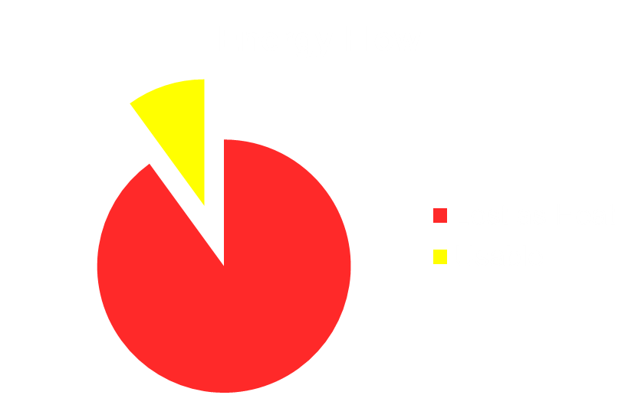
Energy Pyramids
*How efficient is the transfer of energy among organisms in an ecosystem?
Copyright Pearson Prentice Hall
Notes:
*

Slide 11
Energy Pyramids
*Only about 10 % of the energy available within one trophic level is transferred to organisms at the next trophic level.
*90% of the energy is lost as heat (such as chemical reactions in your body during digestion and making new cell parts)!
Copyright Pearson Prentice Hall
Notes:
*

Slide 12
Energy Pyramid
*0.1% Third-level consumers
*Shows the amount of energy available at each trophic level.
*1% Second-level consumers
*10% First-level consumers
*100% Producers
Copyright Pearson Prentice Hall
Notes:
*
Ecological pyramids show the decreasing amounts of energy, living tissue, or number of organisms at successive feeding levels. The pyramid is divided into sections that represent each trophic level. Because each trophic level harvests only about one tenth of the energy from the level below, it can support only about one tenth the amount of living tissue.

Slide 13
3–2
Copyright Pearson Prentice Hall
Notes:
*

Slide 14
3–2
The main source of energy for life on Earth is
organic chemical compounds.
inorganic chemical compounds.
sunlight.
producers.
Copyright Pearson Prentice Hall
Notes:
*

Slide 15
3–2
How does a food web differ from a food chain?
A food web contains a single series of energy transfers.
A food web links many food chains together.
A food web has only one trophic level.
A food web shows how energy passes from producer to consumer.
Copyright Pearson Prentice Hall
Notes:
*

Slide 16
3–2
The amount of energy represented in each trophic level of consumers in an energy pyramid is about
10% of the level below it.
90% of the level below it.
10% more than the level below it.
90% more than the level below it.
Copyright Pearson Prentice Hall
Notes:
*

Slide 17
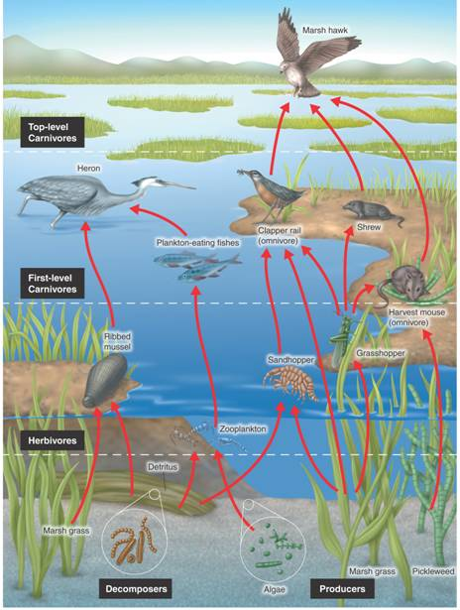
Feeding Relationships
Optional Evidence: This food web shows some of the feeding relationships in a salt-marsh community. Create an energy pyramid from one of the food chains in the picture. Label the amount of energy received from the tropic level before it and if it is a producer, consumer, etc. Also explain what is happening to energy that is lost (dissipated).
Copyright Pearson Prentice Hall
Notes:
*
This illustration of a food web shows some of the feeding relationships in a salt marsh.

Slide 18
Example of Energy pyramid
0.1% energy from sun
3 Consumer
Marsh Hawk
2 Consumer
1% energy from sun
Mouse
10% energy from sun
1 Consumer
Grasshopper
100% energy from sun
Producer
Marsh Grass
Copyright Pearson Prentice Hall

Slide 19
END OF SECTION
Notes:
*

